Slide 1

Smart City Simulation for Emergency Resource Management
Tayyab Shajehan (2023317)
Mian Moiz Ud Din (2023315)

Slide 2
Why We Chose This Project
Smart City Relevance
Efficient Pathfinding
The concept of smart cities is becoming increasingly important in urban planning. This project addresses key problems related to urban mobility, resource allocation, and emergency management.
Pathfinding is used in various real-world systems, including GPS navigation, robotics, gaming, logistics, and autonomous vehicles. This project utilizes efficient pathfinding algorithms, such as Dijkstra's, for real-world applications.

Slide 3
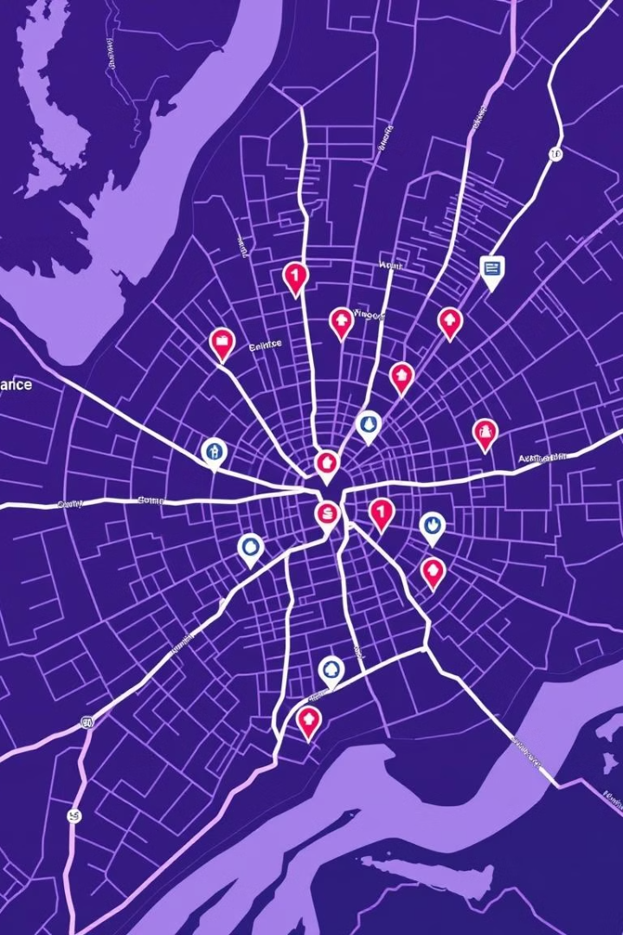
How We Executed Our Code
1
Real-Time Pathfinding
2
Dynamic Traffic Adjustments
The system calculates the shortest paths between locations using Dijkstra's algorithm, ensuring the fastest response to emergencies.
The project incorporates a traffic management system that dynamically adjusts travel times based on real-time traffic conditions.

Slide 4
Graph Representation
1
Graph Representation
2
Undirected Graph
3
Data Storage
The graph is undirected, representing bidirectional routes between locations within the city.
File handling, linked lists, and vectors were employed for efficient storage and manipulation of graph data.
We utilized an adjacency list to represent the city's network, enabling efficient pathfinding calculations.

Slide 5
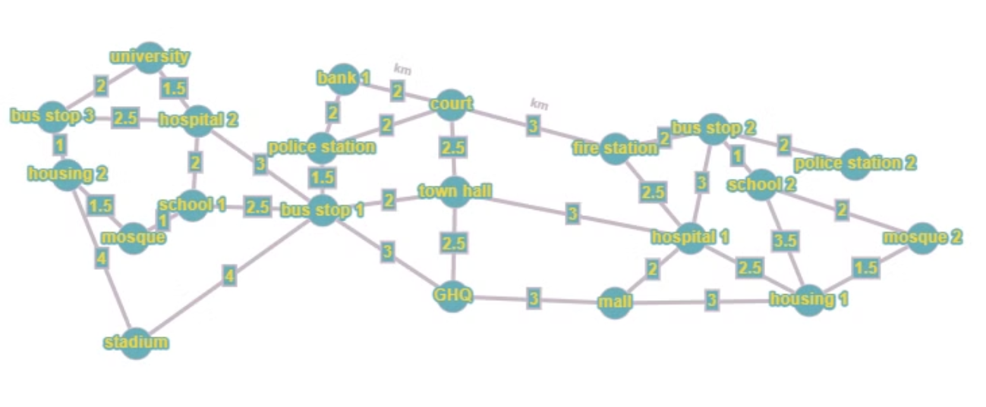
Graph

Slide 6




Project Objectives
Efficient Emergency Management
Dynamic Task Prioritization
Real-Time Pathfinding
Dynamic Traffic Adjustments
Tasks will be prioritized using a dynamic binary search tree (BST) that manages different levels of urgency. This enables real-time prioritization of emergency responses.
The system will calculate the shortest paths between various locations (e.g., hospitals, police stations, fire stations) using Dijkstra's algorithm, ensuring the fastest response to emergencies.
The project will incorporate a traffic management system that dynamically adjusts travel times based on real-time traffic conditions, enhancing the responsiveness of emergency services.
The system aims to efficiently manage resources by identifying the nearest available facilities for various emergency types (medical, fire, and crime) in the shortest possible time.

Slide 7




Future Directions
Real-time Traffic Data
Integrate real-time traffic data from external sources, making the simulation more realistic and responsive to live events.
Real-time Emergency Data
Introduce data from emergency services that dynamically updates the resource management system, adjusting to real-world emergencies.
A\* Algorithm
Integrate the A\* algorithm for more efficient pathfinding, combining the best aspects of Dijkstra's algorithm and heuristics.

